Slide 1

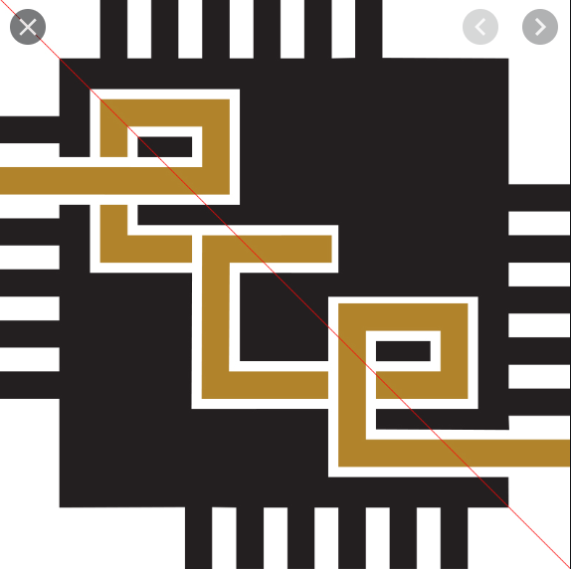
CLASSIFICATION OF STARS AND QUASARS USING KNN
Group members:
Sai sree PES1201701763
Shreya V Deexit PES1201701648

Slide 2
INTRODUCTION
Machine learning involves the use of statistics to make useful predictions and to learn essential features; classification is the process of marking separations between categories in data.
Supervised machine learning techniques make use of labelled data to make predictions of future unseen data. In the present context, the labels in the data comprise of numeric indications of a source being a star or a quasar.
We are using KNN, a machine learning classifier to classify these stars and quasars without spectroscopic data, by using other parameters.

Slide 3
PROBLEM STATEMENT
Classification of stars and quasars with the photometric data which includes five broad band filter values.
With the help of spectroscopic red shift, we can easily classify the star or a quasar.But calculation of those values are difficult.So by using other parameters like u,g we classify accordingly

Slide 4
METHODOLOGY
Preprocessing data:
PRE-PROCESSING
CHOOSING THE MODEL
WORKING ON KNN
CHOOSING K VALUE IN KNN
CALCULATING ACCURACY
The columns in the csv file contains five broad-band filters u, g, r, i, z values which determine the location of star or quasars.
We have dropped the unnamed , galex_objid ,sdss_objid,spectrometric_redshift , pred columns from the dataset given as they don’t contribute to knowing
the distances between two instances.
We have performed upsampling on the minority particles(quasars) to make balanced data otherwise accuray for quasars will be very less

Slide 5
PREPROCESSING
CHOOSING THE MODEL
WORKING ON KNN
CHOOSING K VALUE IN KNN
CALCULATING ACCURACY
k-nearest neighbors algorithm (k-NN) is a non-parametric method used for Classification and Regression.
A k-nearest-neighbor algorithm, often abbreviated k-nn, is an approach to data classification that estimates how likely a data point is to be a member of one group or the other depending on what group the data points nearest to it are in.

Slide 6


PREPROCESSING
CHOOSING HE MODEL
WORKING ON KNN
CHOOSING K VALUE IN KNN
CALCULATING ACCURACY
It works based on minimum distance from the query instance to the training samples to determine the K-nearest neighbors to be the prediction of the query instance.
Distances are calculated by using
1.Euclidean distance:
2.Manhatten Distance:

Slide 7
PREPROCESSING
CHOOSING THE MODEL
WORKING ON KNN
CHOOSING K
VALUE IN KNN
CALCULATING ACCURACY
A small value of k means that noise will have a higher influence on the result and a large value make it computationally expensive. Its advisable to choose as an odd number if the number of classes is 2 and another simple approach to select k is set k=sqrt(n). we are choosing k = 7 for all tests after examining the accuracies for k=5,7,9.

Slide 8
PREPROCESSING
CHOOSING THE MODEL
WORKING ON KNN
CHOOSING K VALUE IN KNN
CALCULATING ACCURACY
We tested our model on catalog1,catalog2 for k values 5,7,9 and came to the conclusion of using k=7. The results of this test are as follows:
For cat1:
k=5 Accuracy: 98.05546218487%
k=7 Accuracy: 98.15126050420%
k=9 Accuracy: 97.058823529411%

Slide 9
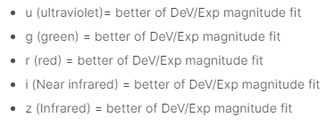
TOOLS AND DATA SET USED
Tools:
Jupyter notebook
Modules used:
Pandas-To perform operations on .csv dataset
resample-To upsample the data such that data is equally split and there are no chances of bias
Dataset:
Photometric data which are cat1.csv and cat2.csv files
contains the location of stars and quasars in some region 1 and 2.
cat3.csv was used in the training as it contains the values of u, g, r, i, z both in region 1 and region 2.

Slide 10
IMPLEMENTATION
1. Load the data
2. Initialise the value of k.
3. For getting the predicted class, iterate from 1 to total number of training data points:
Calculate the distance between test data and each row of training data. Here we will use Euclidean distance as our distance metric since it’s the most popular method. The other metrics that can be used are Chebyshev, cosine, etc.
Sort the calculated distances in ascending order based on distance values.
Get top k rows from the sorted array.
Get the most frequent class of these rows.
Return the predicted class.

Slide 11
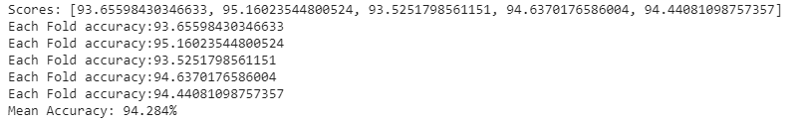
RESULTS AND ANALYSIS
Test results of region1, region2 for k=7
Test results using cat3, for k fold method,k=7 and number of folds=5
Csv file | Accuracy | Class 0 | Class 1
1 | 98.15126 | 100.00 | 96.3025
2 | 97.2901 | 99.9313 | 94.6423

Slide 12
CONCLUSION
The stars and quasars were classified according to the given five band values and without using spectrometric redshift.
The classification and identification of quasars is fundamental to many astronomical research areas. Given the large volume of photometric survey data available in the near future, automated methods for doing so are required.
For a two class classification problem, choosing odd values of k would increase the accuracy and knn method is time consuming

Slide 13
REFERENCES
[1] Separating Stars from Quasars: Machine Learning Investigation Using Photometric Data,Simran Makhija,∗, Snehanshu Saha, Suryoday Basak, Mousumi Das.
[2] Machine Learning Mastery website.
[3] https://www.analyticsvidhya.com/blog/2018/03/introduction-k-neighb ours-algorithm-clustering/

Slide 14
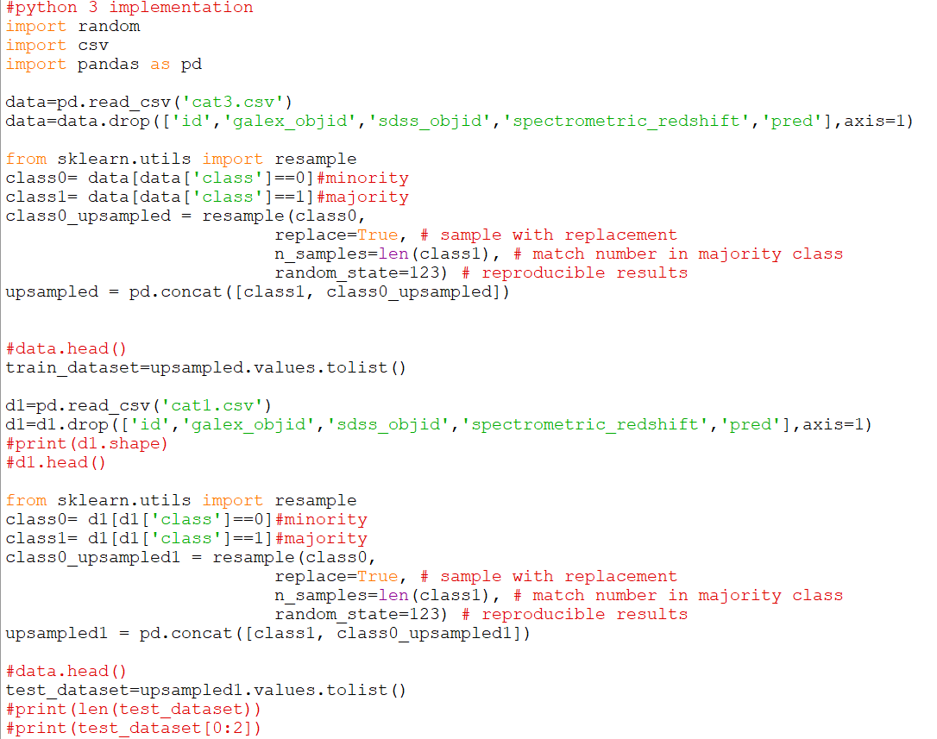
APPENDIX

Slide 15
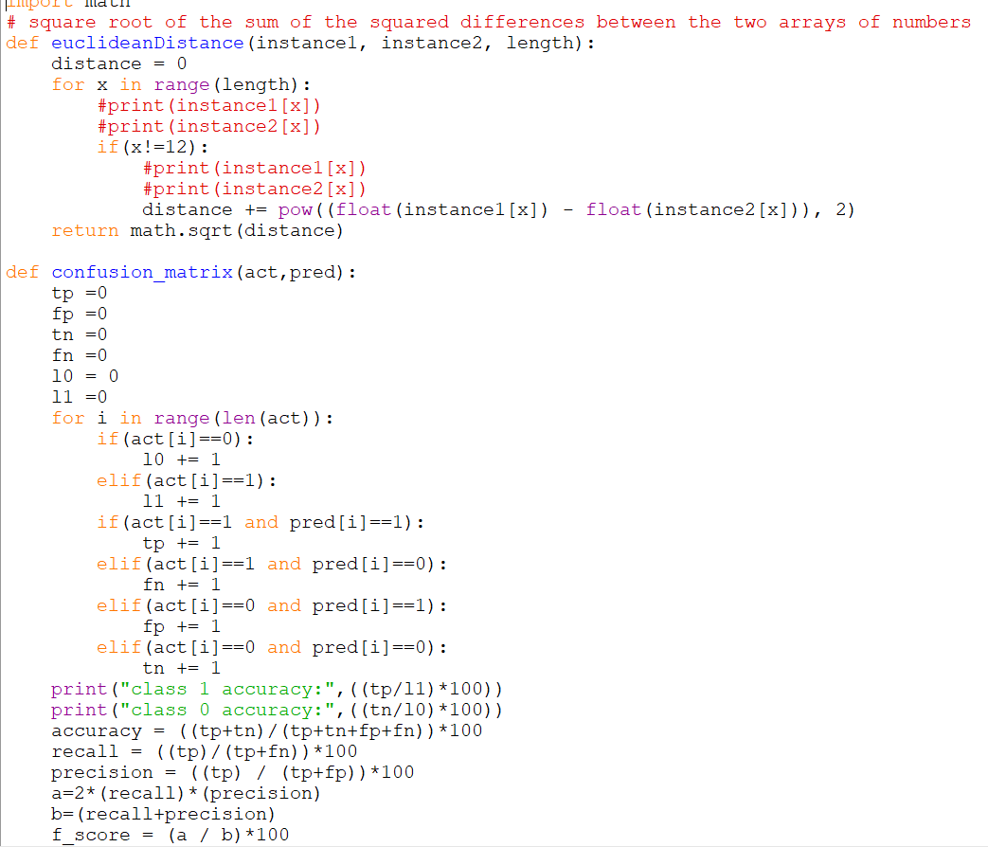

Slide 16
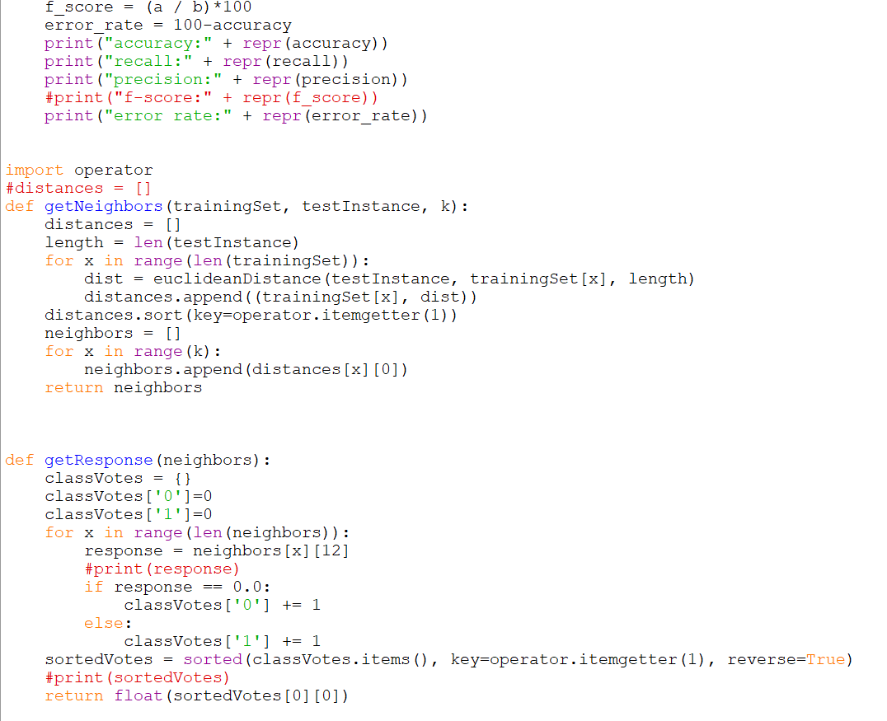

Slide 17
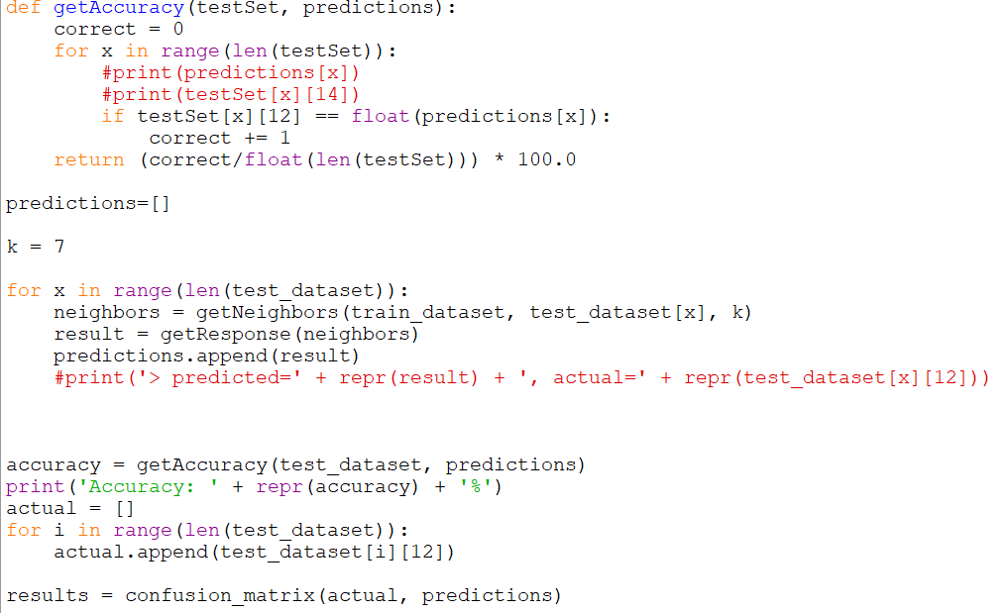

Slide 18
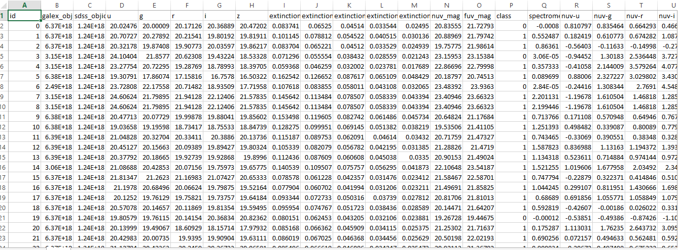
Dataset
https://www.kaggle.com/farazrahman/predicting-star-galaxy-quasar-with-svm

